Slide 1

BrainQuest: Unlock Your Potential
Welcome to BrainQuest, where learning meets adventure. Sharpen your mind, conquer challenges, and explore new fields of study.

Slide 2

Your Journey with BrainQuest
45
29
12
Power Level
Total Quests
Questions Today
Sanmesh, an Explorer in the Medical field, is on a 1-day streak!

Slide 3


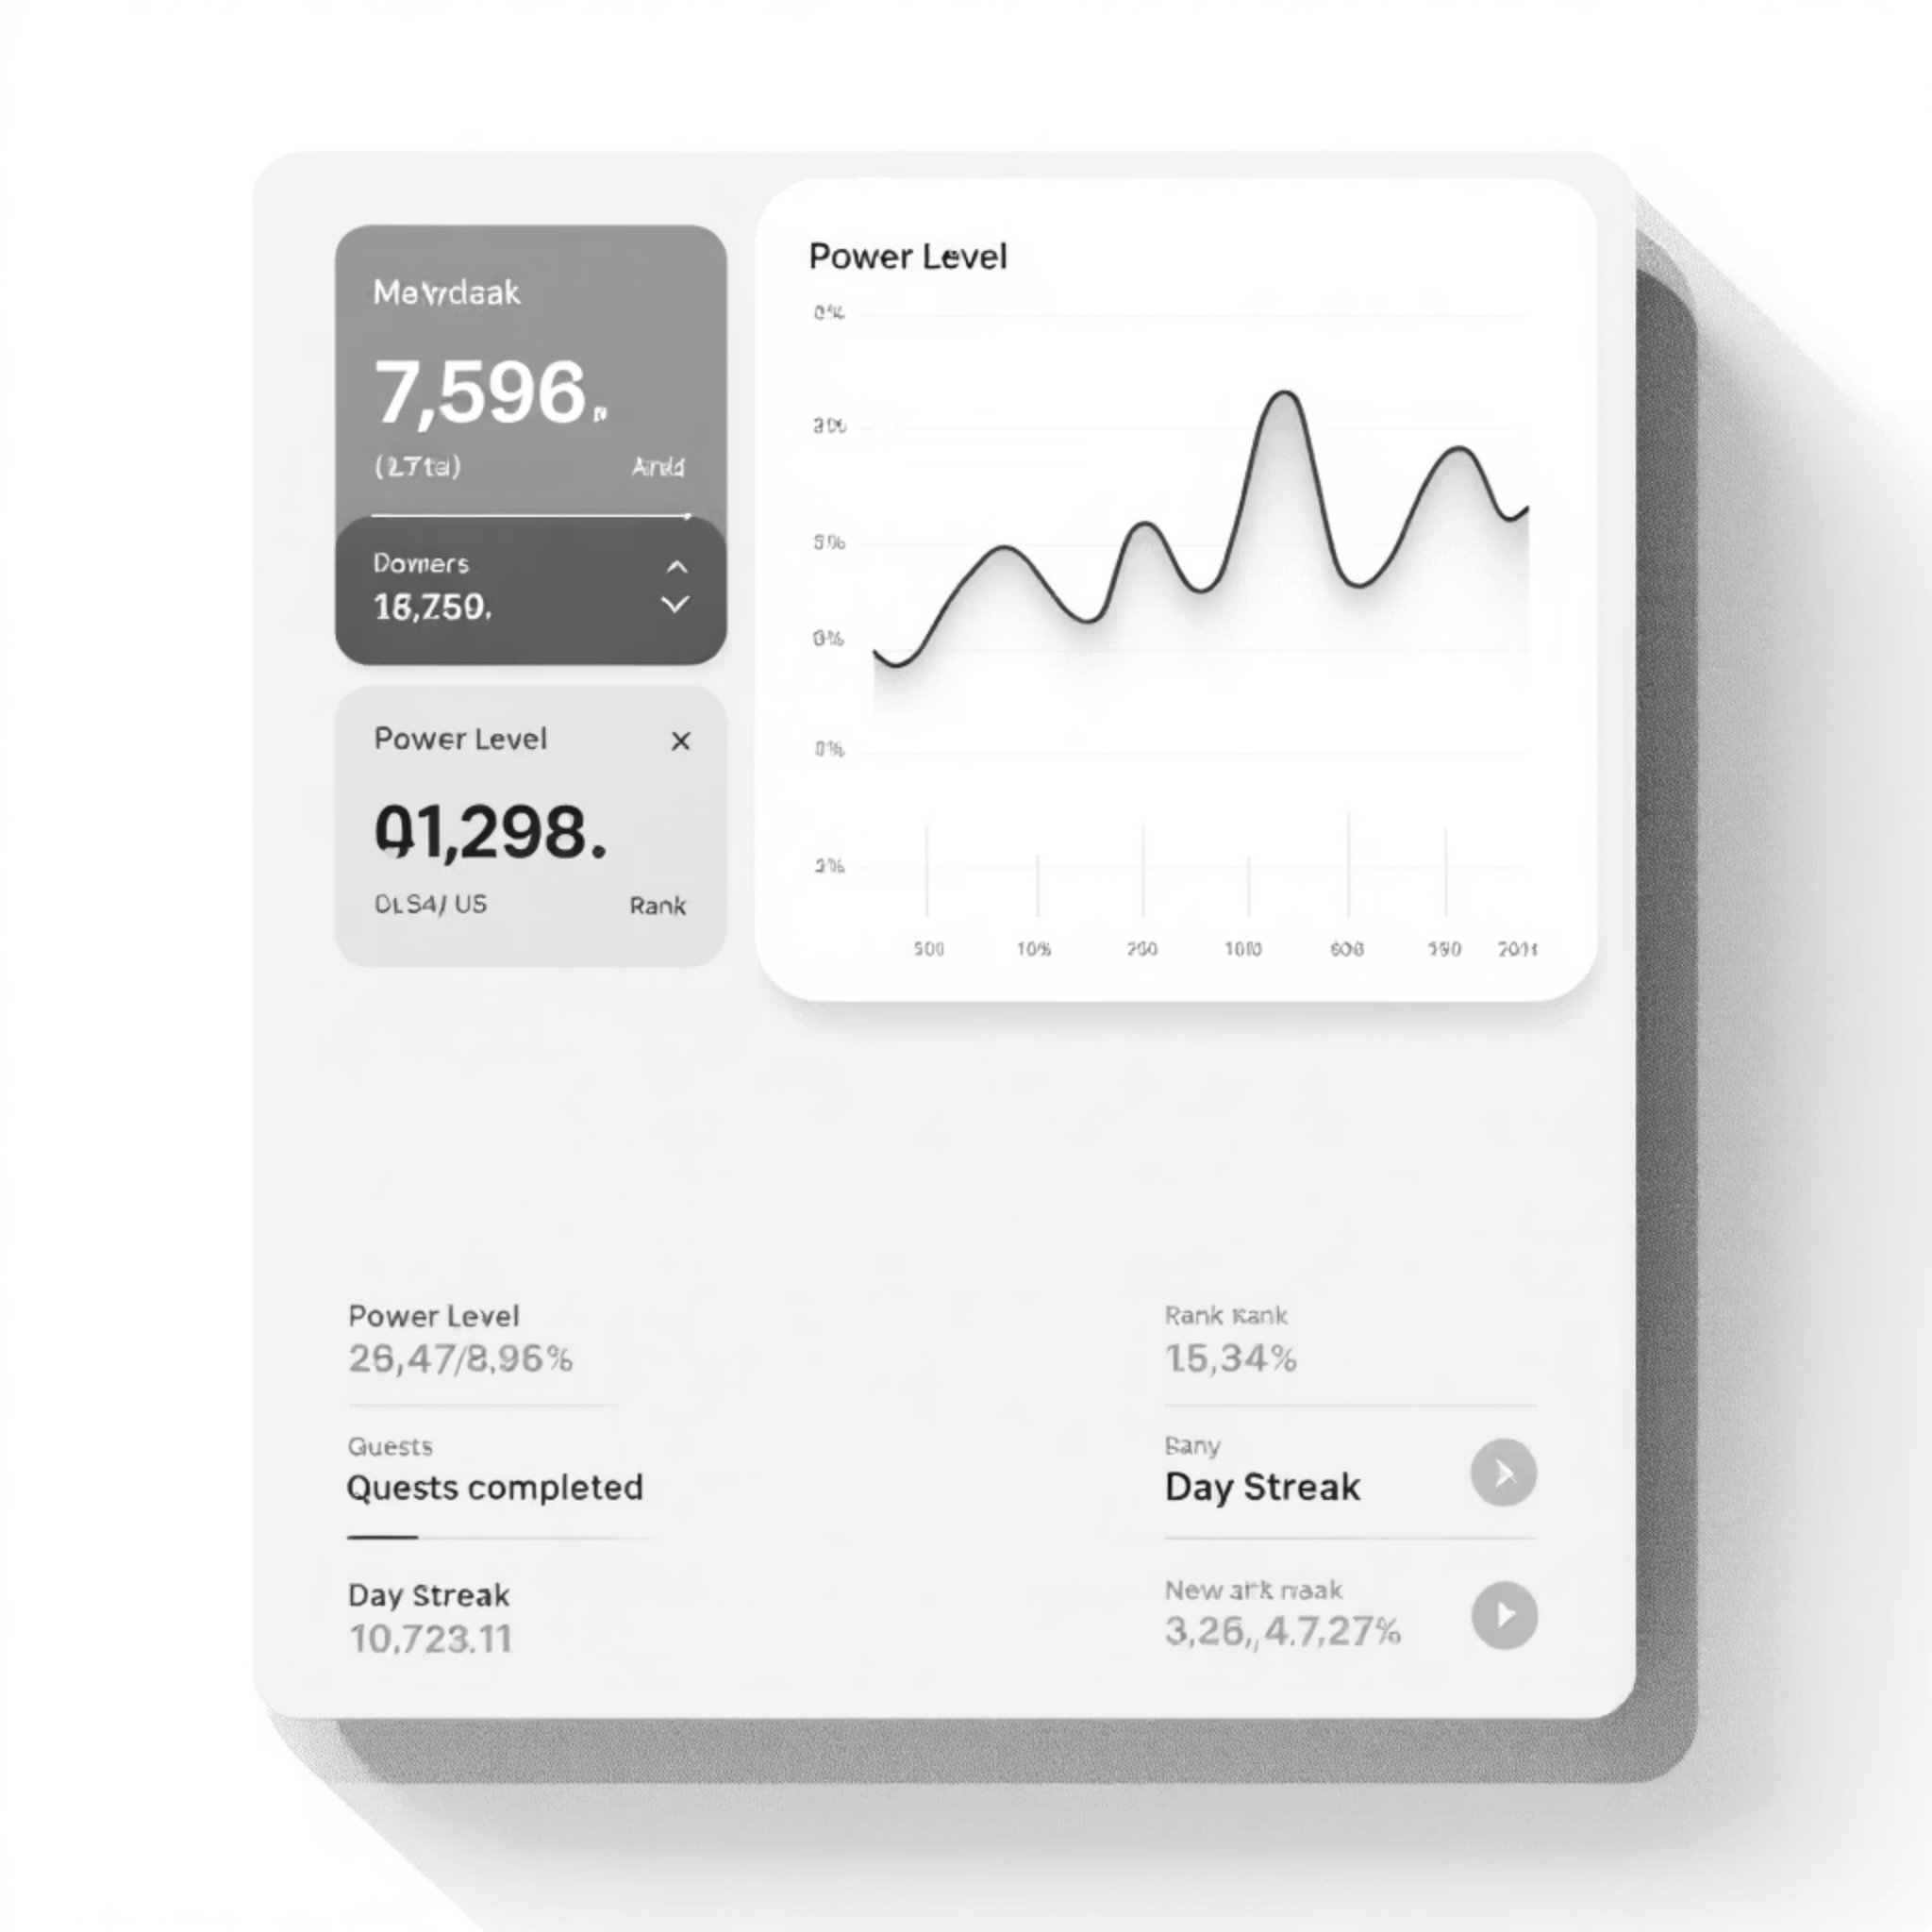
Elevate Your Stats
Power Level: 61
Watch yourself level up every day!
Quests Done: 39
Every quest makes your brain more powerful!
Rank: Master
Achieve mastery in your chosen fields.
Day Streak: 1
Keep the momentum going!

Slide 4

Strength Bars: Sharpen Your Mind
You're thinking faster today! 🚀
98%
45%
Puzzle Master
Story Master
BrainQuest helps you identify and boost your cognitive strengths.

Slide 5



Ready for Your Next Adventure?
Every quest makes your brain more powerful!
Play Today's Challenge
Medical Field of Study

Slide 6

Logic Challenge: Test Your Wits
Let's see how sharp your brain is today!
I speak without a mouth and hear without ears. I have no body, but come alive with wind. What am I?
A shadow
An echo
A ghost
A whisper
Question 1 of 10

Slide 7

The Play Zone: Choose Your Adventure
Every game sharpens your mind!
Logic Puzzles
Crack mind-bending riddles. Boosts: Thinking Speed.
Number Quest
Solve numerical mysteries. Boosts: Pattern Recognition.
Story Adventures
Shape your journey with choices. Boosts: Decision Making.

Slide 8

Special Challenges
Eagle Eye
Quick Choices
Speed Challenge
Spot patterns and hidden details to boost observation skills.
Make smart decisions under pressure, enhancing critical thinking.
Test your reflexes and quick thinking for rapid response.

Slide 9

The Secret Behind BrainQuest
What Students See:
What Happens Behind:
Fun games
Exciting stories
Building thinking skills
Levels and streaks
Measuring speed & accuracy
Challenges to conquer
Detecting weak areas
AI guide support
Adjusting difficulty
Personalizing learning path

Slide 10

Personalized Learning with AI Guide
Get personalized tips and guidance from your AI mentor. Our AI adapts to your progress, ensuring an optimal learning experience.
Custom Challenges
Adaptive Difficulty
Tailored to your field of interest.
Adjusts as you improve.
Targeted Feedback
Focuses on your weak areas.

